Slide 1

ASIAN BCA COLLEGE
Project Presentation On
“Hospital management system”
Group Member :-
1.thakarda axay d.
2.Chauhan aarti r.
3.pandor Roshni b.
Project Guide :-
mr. brijesh gameti

Slide 2
Project Name | Hospital Management System
Purpose | To provide fast and accurate services to patient. To manage the data and information about the status appointments and patient details.
Front – End | HTML, CSS, JS
Back – End | PHP & Mysql
Web Server | Apache 2.4.63
Supporting tool | MS office-2024, Drow.io
Project Guide | Mr. Brijesh Gameti
Developed By | Thakarda Axay, Chauhan Aarti, Pandor Roshni

Slide 3
objective
To provide fast and accurate services to patient.
To manage the data and information about the status appointments and patient details.
Simplifying the process for patients and doctors to coordinate appointments.
Safeguarding sensitive information related to patients, staff, and hospital operations.
Providing analytics and reports for better decision-making.

Slide 4
Overview of website
The project hospital management system includes registration of patient , storing their details into the system , and also computerized billing in the pharmacy , and labs. The software has the facility to give a unique id for every patient and stores the details of every patient and the staff automatically .It include a search facility to know the current status of each room. User can search availability of a doctor and the details of a patient using the id.
The hospital management system can be entered using and password. It is accessible either by an administrator or receptionist. only they can add into the database. The data can be retrieved easily. The interface is very user-friendly . the data are well protected for personal use and makes the data processing very fast.
The purpose of the project entitled as “HOSPITAL MANAGEMENT SYSTEM ” is to computerize the front office management of hospital to diagnosis, etc.
The main function of the system is to register and store patient details and doctor details and retrieve these details as and when required, and also to manipulate these details meaningfully system input contains patient details, diagnosis details while system output is to get these details on to the crt scree.

Slide 5
features
Dynamic and responsive web – site
User login and registration
Online book appointment
Online job apply
Staff management and patient management
Invoice management

Slide 6
advantages
Enhanced Efficiency
Centralized Data Management
Cost Reduction
Data Security and Compliance
disadvantages
High Initial Investment
Security Risks
Maintenance and Updates

Slide 7
Problem statement
Hospitals face numerous challenges in managing their operations effectively due to outdated manual processes, fragmented systems, and a lack of centralized data management. These issues lead to inefficiencies such as delayed patient care, errors in record-keeping, difficulty in tracking resources, and poor communication between departments.
Ensuring Data Security and compliance with Healthcare Regulations Remains a Significant Concern.
Require More Staff.

Slide 8
Need for new system
Outdated Technology: Existing systems are often based on old technologies that struggle to keep up with the growing complexities of hospital operations.
Inefficient Processes: Manual and fragmented processes lead to delays, errors, and increased administrative burden, negatively impacting patient care and staff productivity.

Slide 9
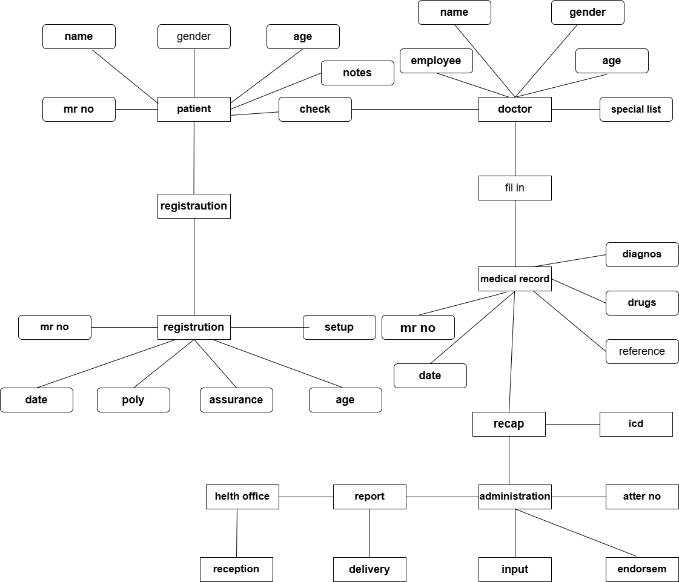
ER - Diagram

Slide 10
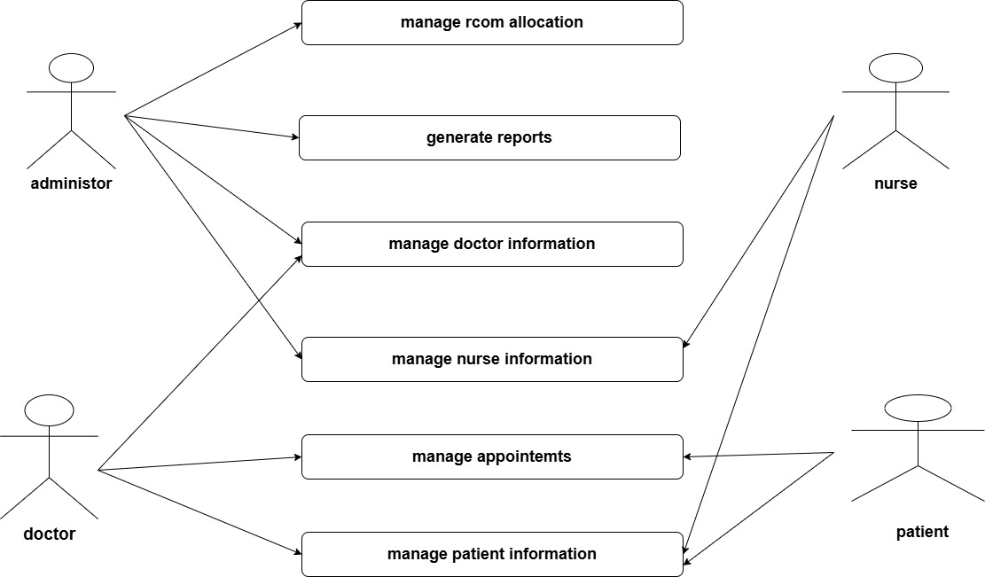
Usecase diagram

Slide 11
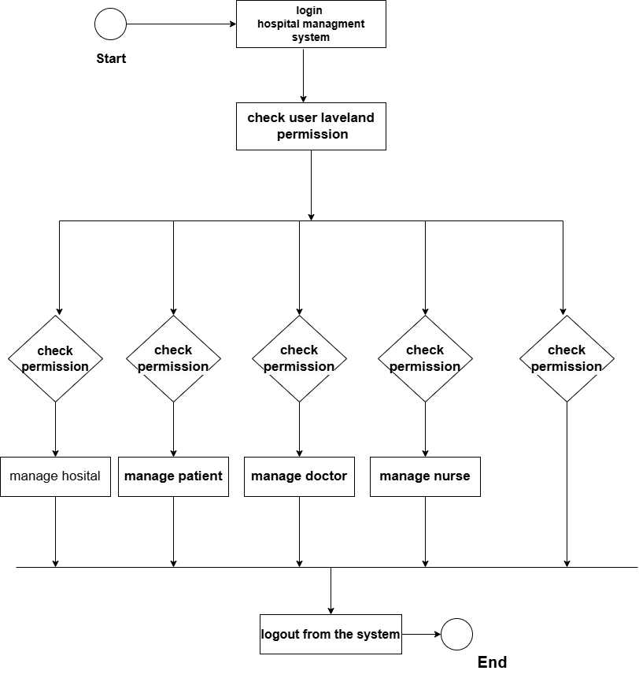
Activity diagram

Slide 12
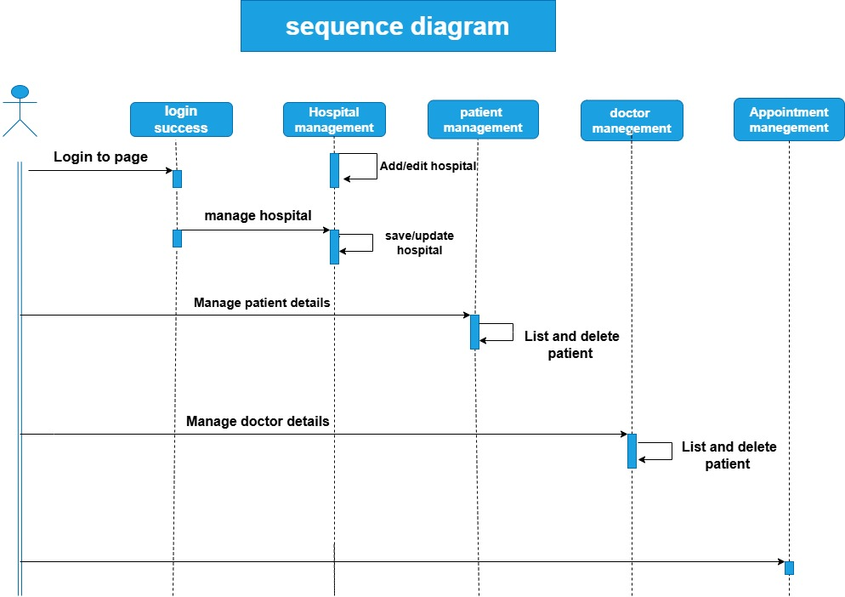

Slide 13
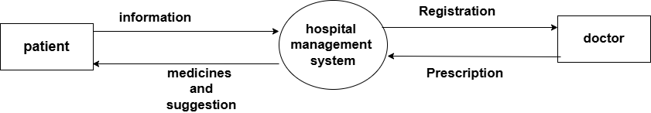
DFD 0 LEVEL

Slide 14
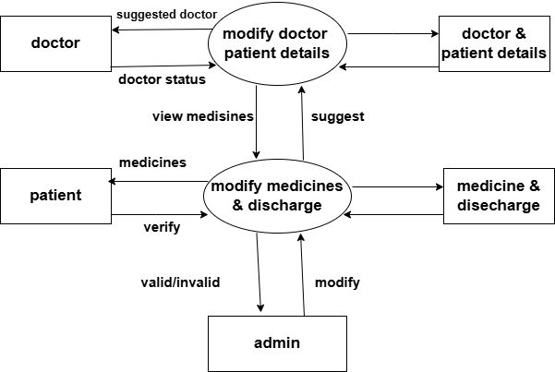
DFD 1 LEVEL

Slide 15
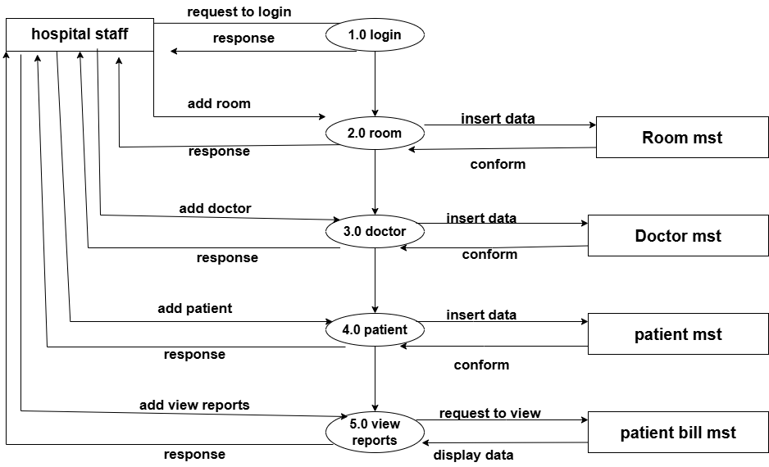
2 LEVEL DFD

Slide 16

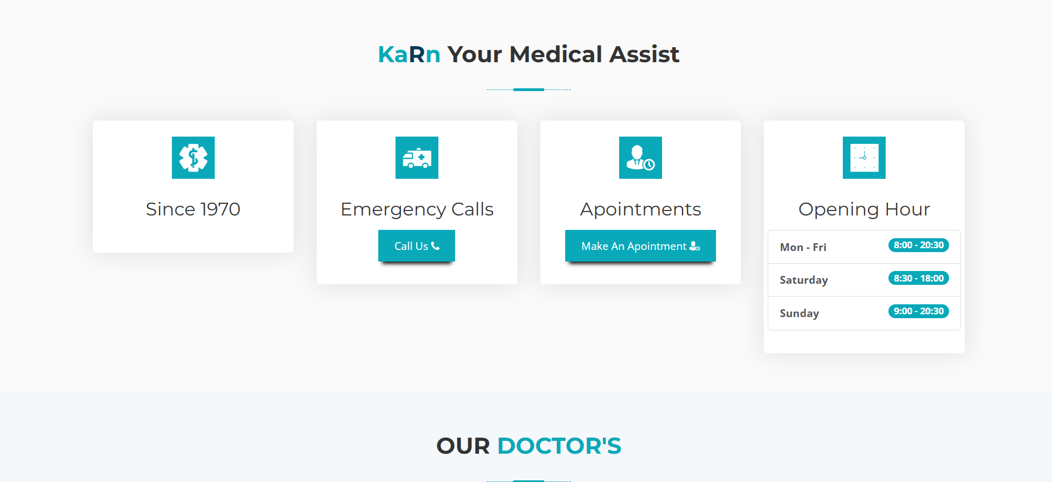

HOME PAGE :-

Slide 17


About US Page :-

Slide 18
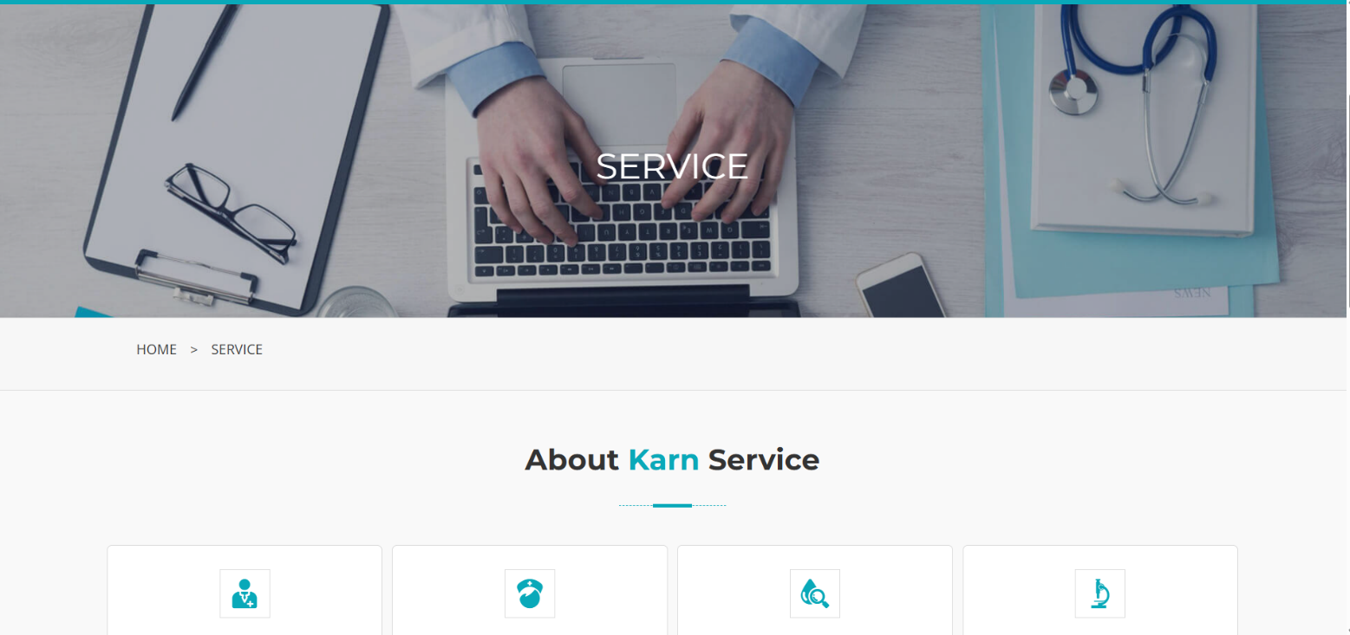
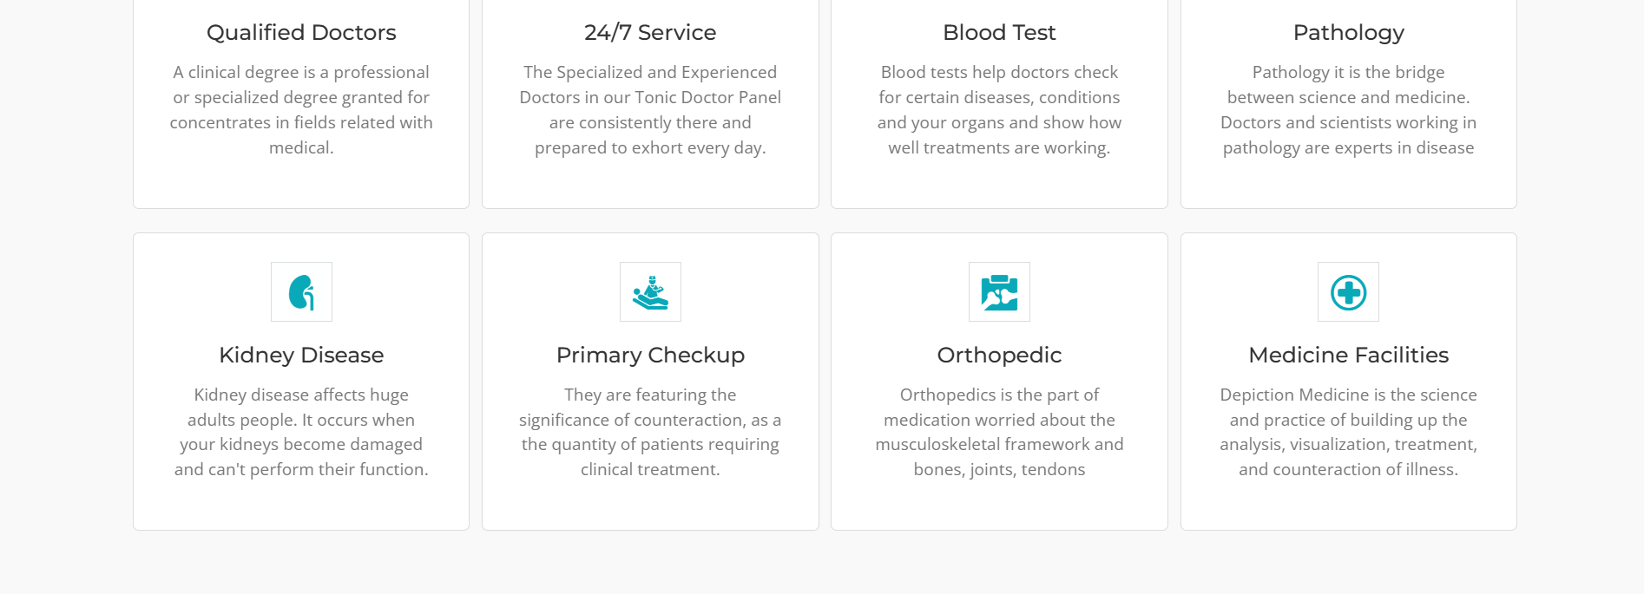
Service Page :-

Slide 19


Team Page :-

Slide 20


Department Page :-

Slide 21
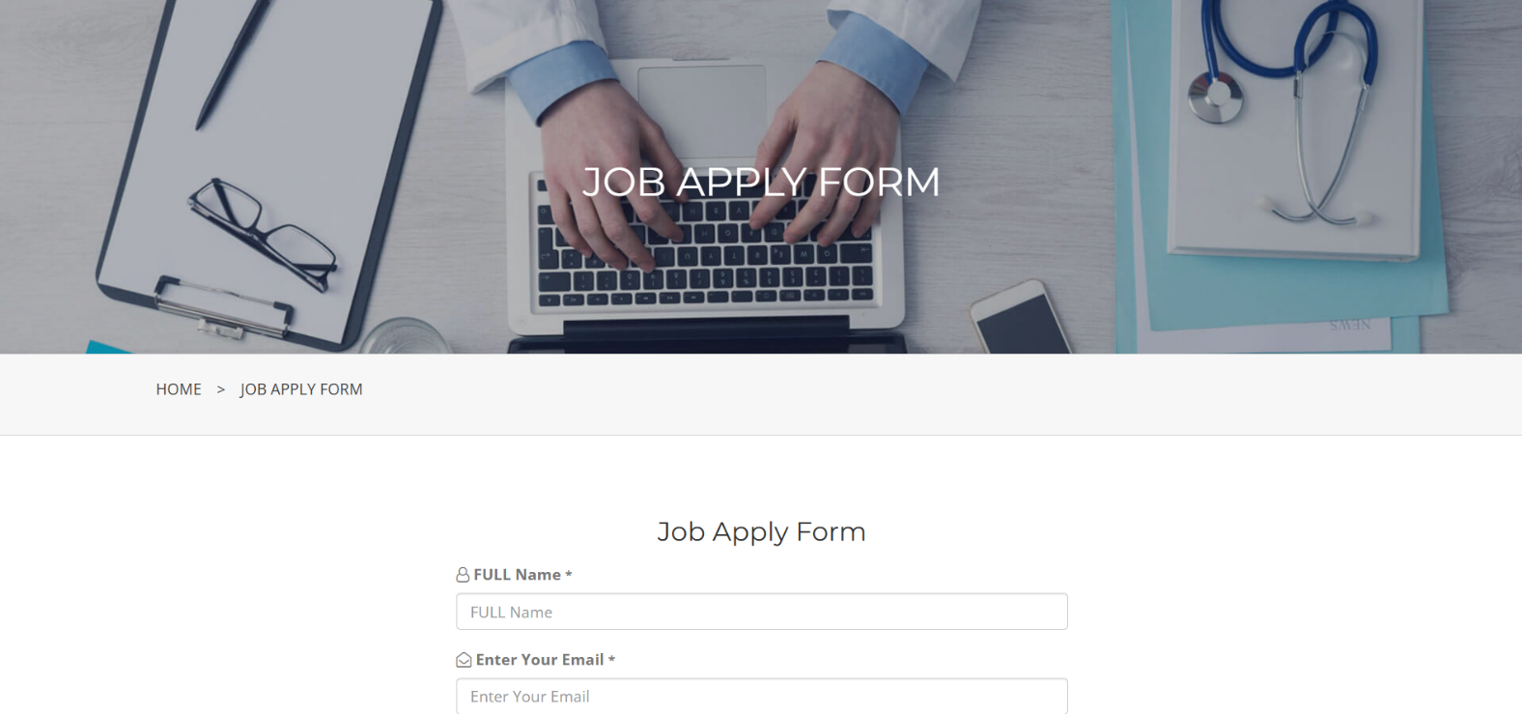
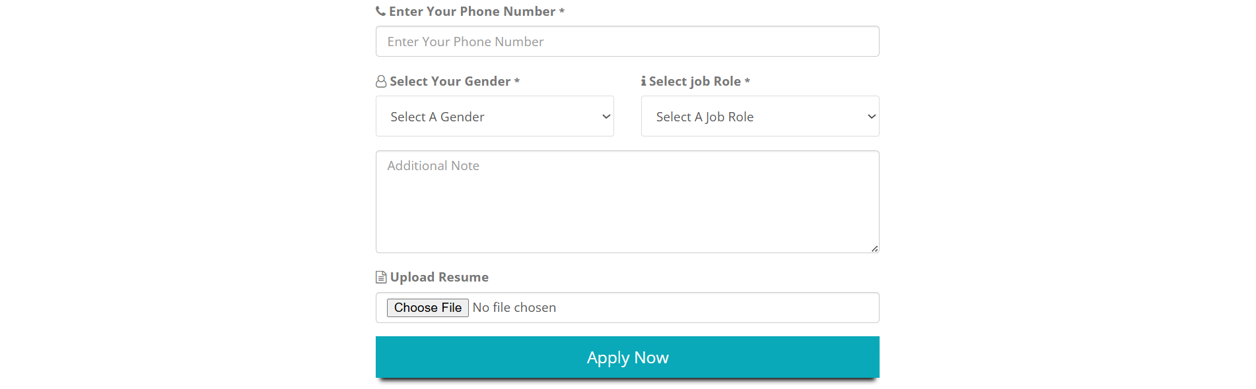
Job Apply Page :-

Slide 22
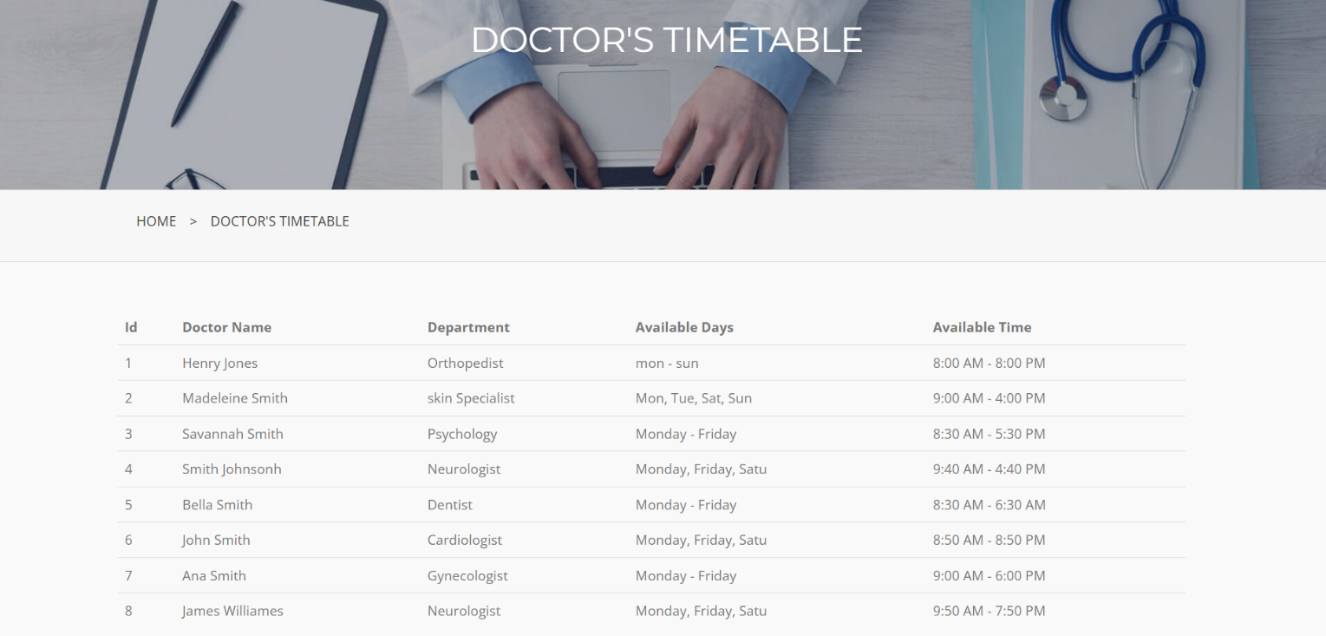

Doctor’s Time Table Page :-

Slide 23

Registration Page :-

Slide 24

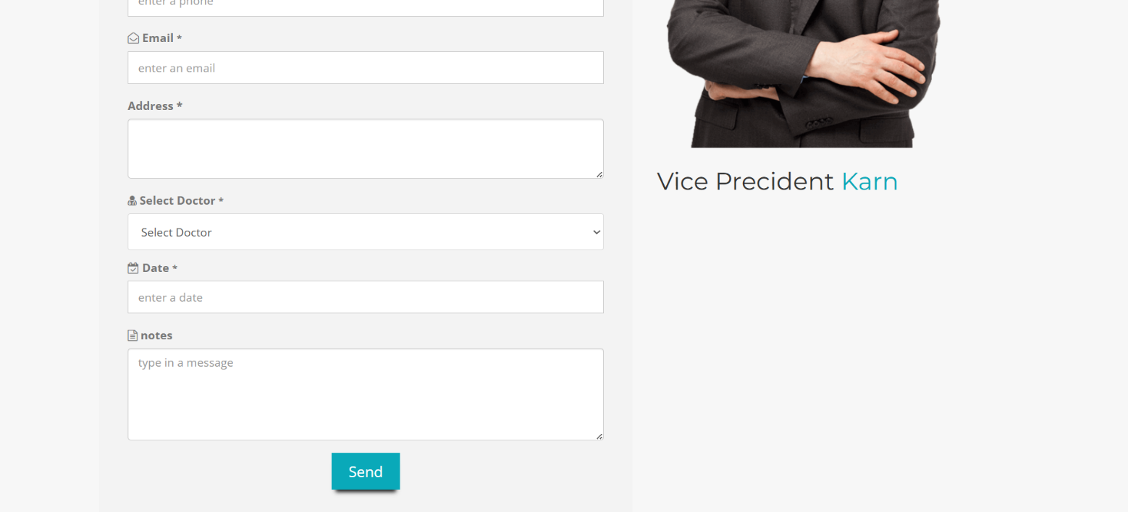
Appointment Page :-

Slide 25

Admin Login Page :-

Slide 26
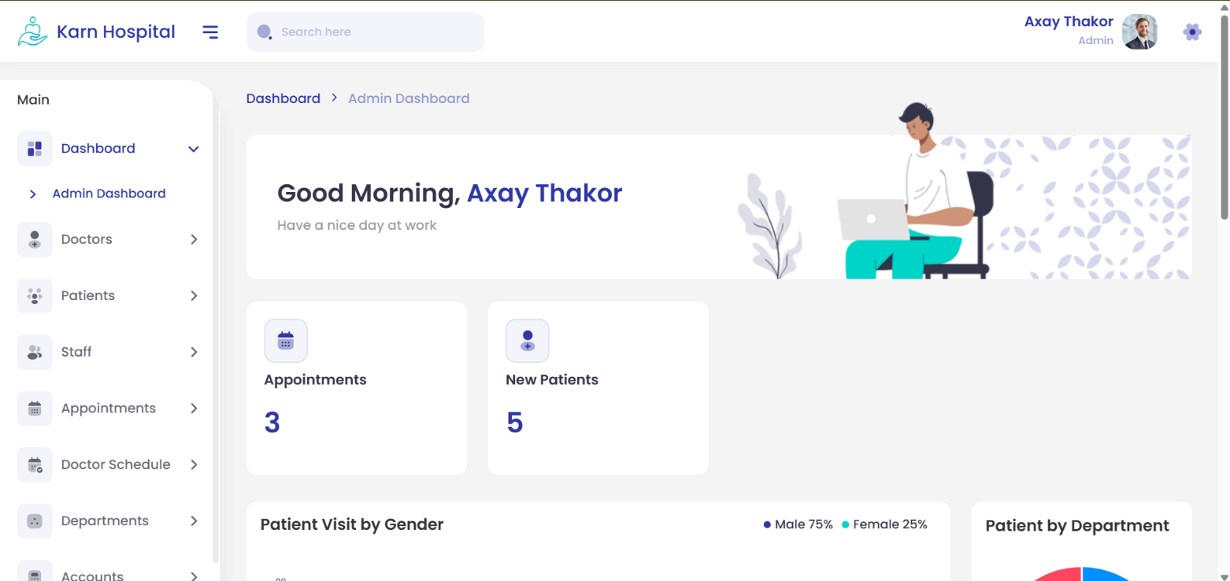
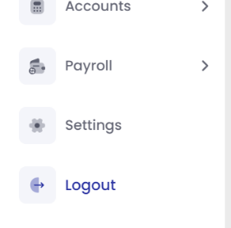
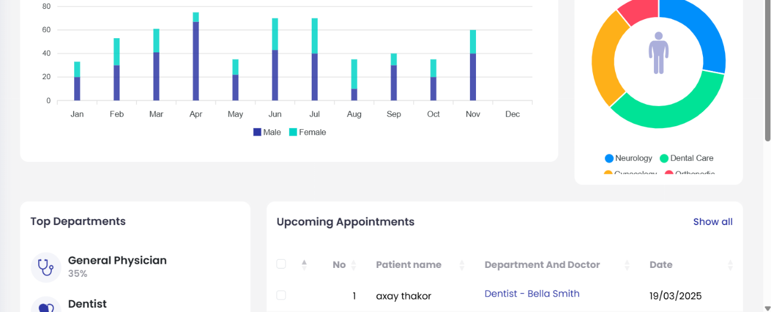
Admin Dashboard Page :-

Slide 27
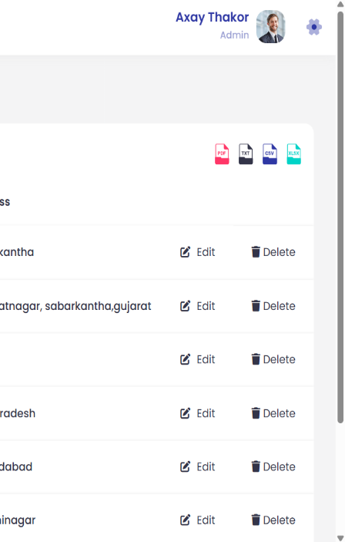
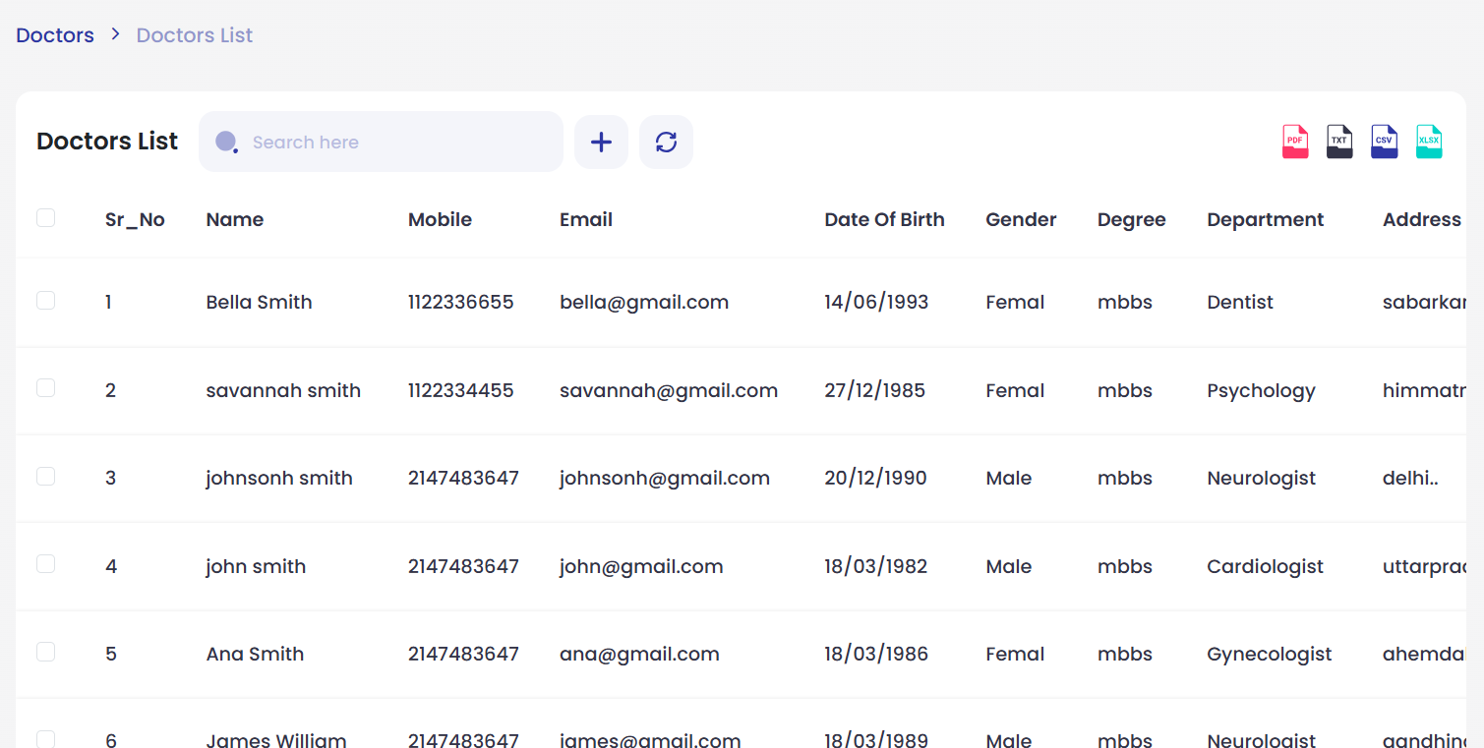
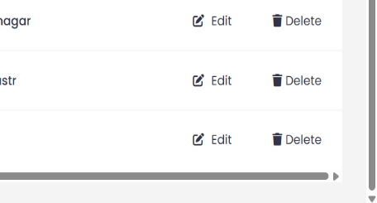
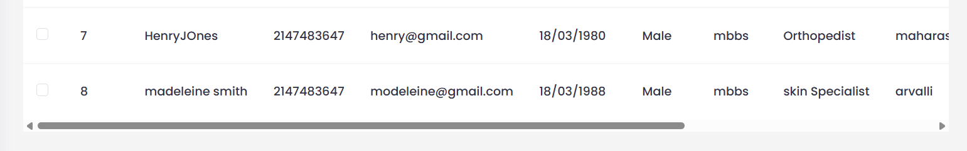
Doctor list Page :-

Slide 28
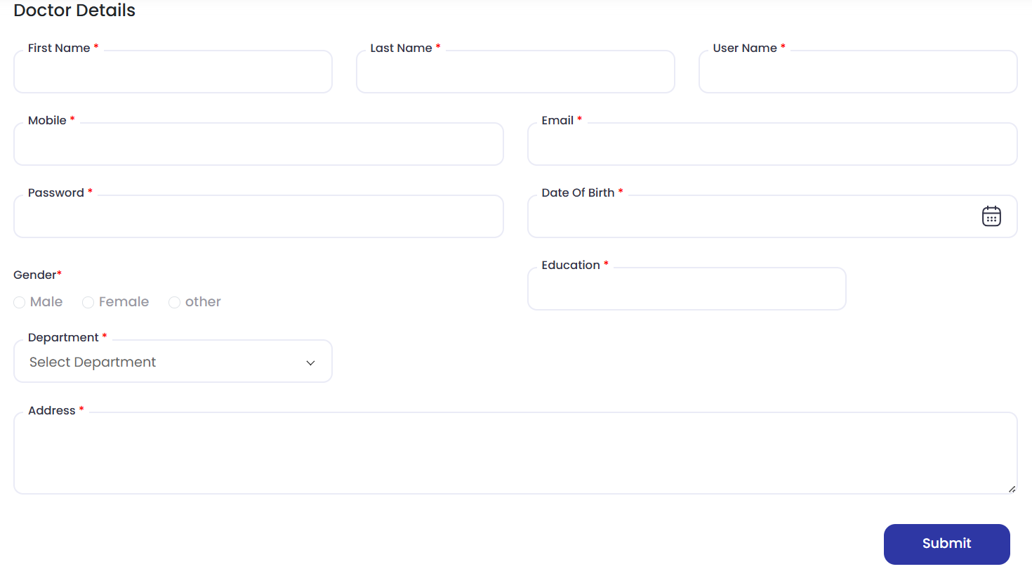
Add Doctor Page :-

Slide 29
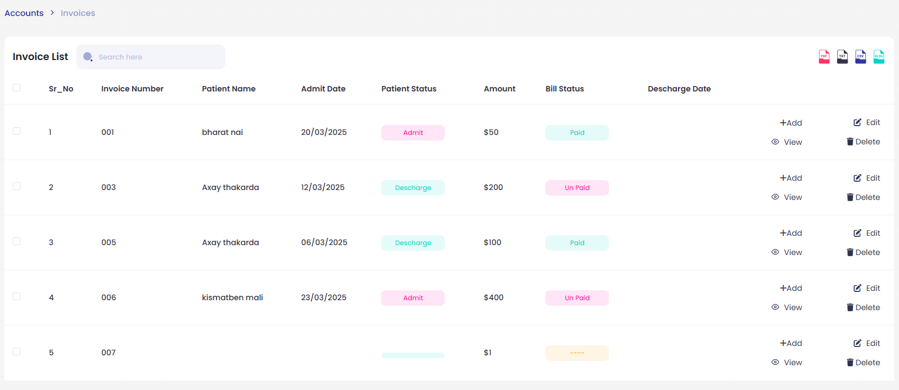
Invoice List Page :-

Slide 30
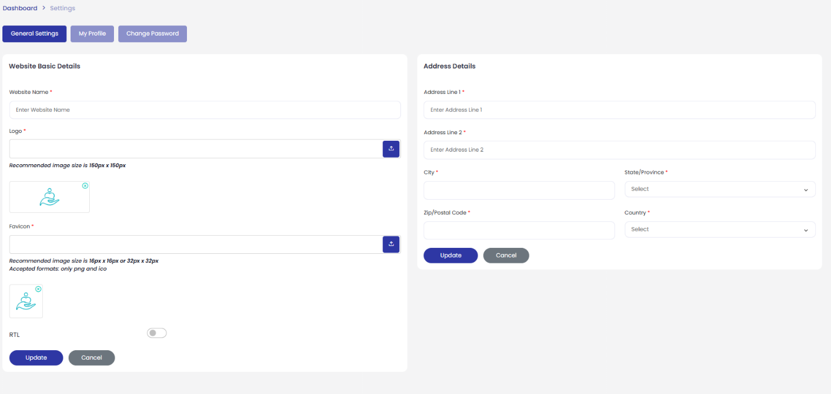
Setting Page :-

Slide 31
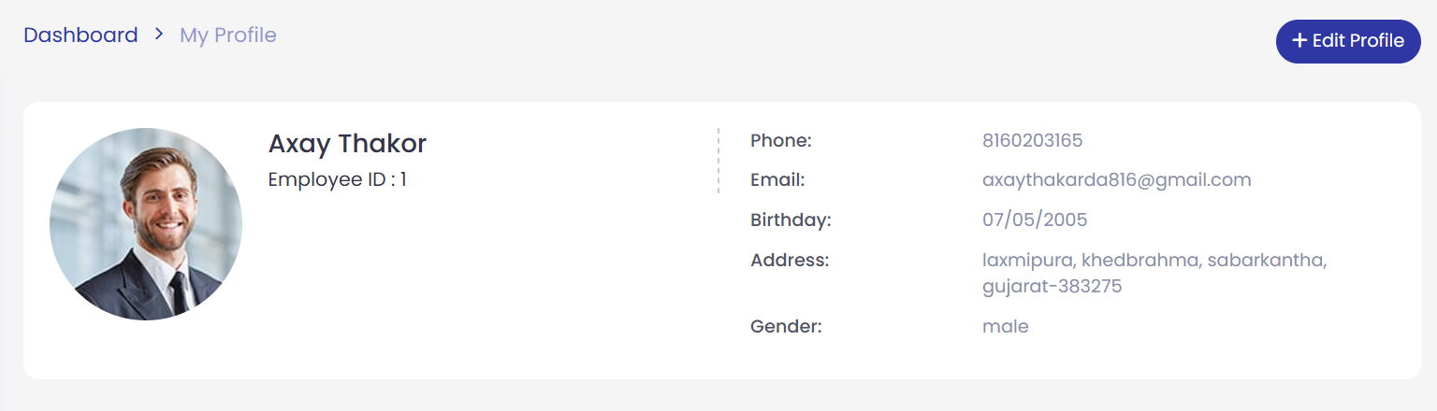
My Profile Page :-

Slide 32
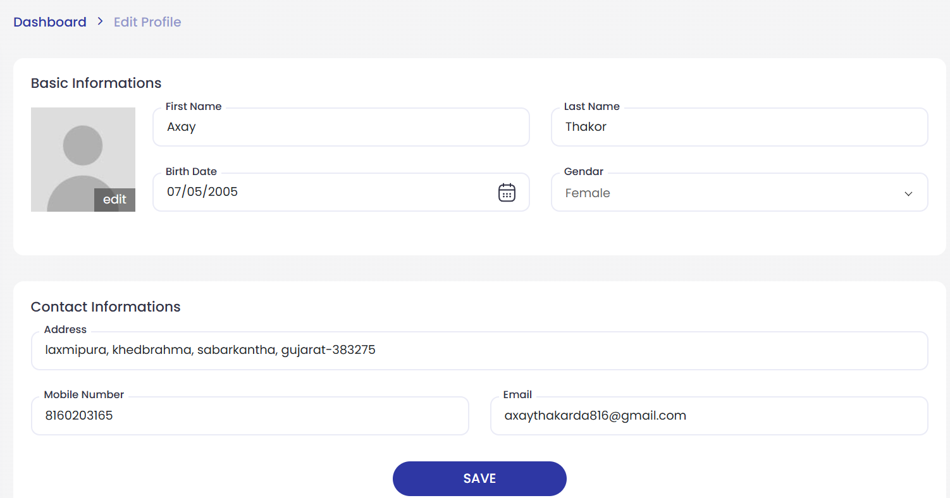
Edit Profile Page :-

Slide 33
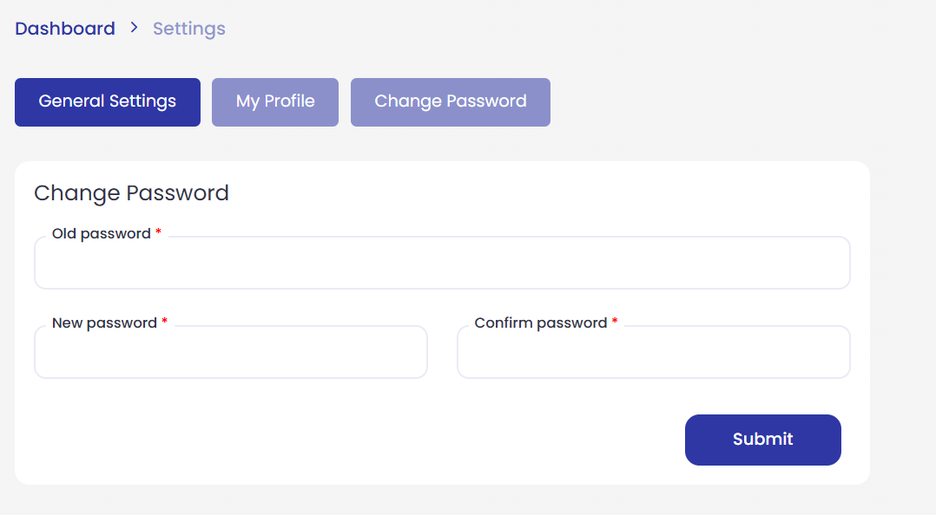
Change Password Page :-

Slide 34
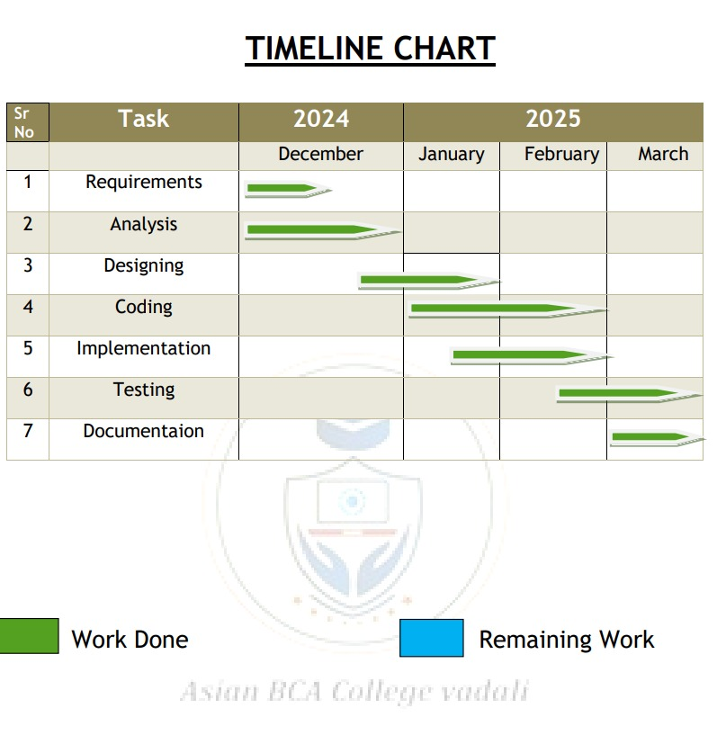
TIMELINE CHART

Slide 35
THANK YOU

